Slide 1
Returning Citizens Re-entry Program
DSPG Summer 2019

Slide 2
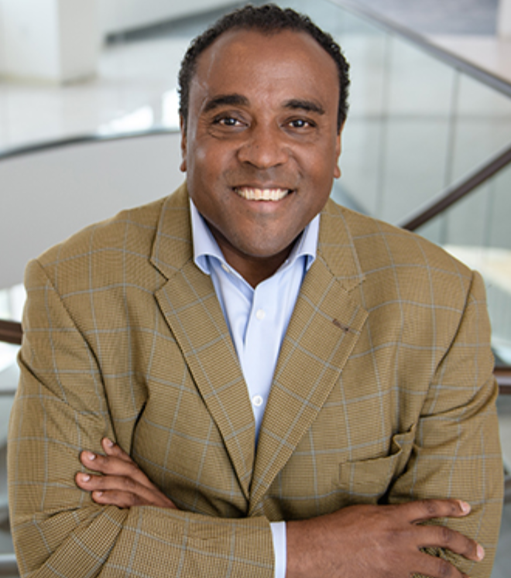
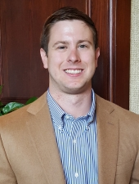
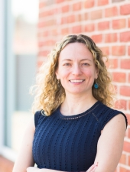
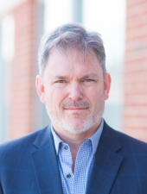
Project Team
Initiator
Gregory Fairchild
Darden Graduate School of Business Administration
Lead
Nathaniel (“Nat”) Ratcliff
SDAD
Gizem Korkmaz
SDAD
Aaron Schroeder
SDAD
Along with Bayoán Santiago, Joel Thurston, and YOU

Slide 3

Project Background
Since the spring of 2011, UVA’s Darden Gradate School of Business Administration and Virginia’s Department of Corrections (VADOC) have partnered to provide entrepreneurship training at the Dillwyn and Fluvanna Correctional Centers
As a component of VADOC’s Resilience Education Programing, the Entrepreneurial Re-Entry Program addresses learning related to financial capability, personal finance, entrepreneurship, and foundations in business all taught by MBA students within Darden
The goal of the program is to provide offenders with the personal and professional skills that promote financial stability and self-employment prior to release so that these individuals can have increased employment opportunities and options once they re-enter society as citizens
Because the program is still in its early stages, there is little research evaluating its impact on prisoners once released (e.g., employment, recidivism)

Slide 4
Research Proposal
Literature Review: Synthesize the research on education while incarcerated and identify potential gaps
Research Question Identification: Develop research questions that can inform the resilience education program
Data Discovery: Identify pre-existing data sources to support research study design
Data Analysis: Analyze available data sources
Memorandum of Recommendations: Provide recommendations on study design to evaluate the resilience education program

Slide 5
Skills Desired and Developed
Skills Desired: Creativity, interest in research design, empathy
Skills Developed:
  Learn how to ‘get smart’ on a topic to develop a project from the nascent stages of research planning and design
  Learn how to synthesize the research literature and identify empirical gaps
  Learn how to discover and analyze data sources to use in support of research planning
  Learn how to design a study for program evaluation
  Learn to communicate and provide stakeholders with recommendations

